Slide 1

Global EV Sales 2010 - 2024
BODDU SHIREESHA
BATCH NO:456
Innomatics Research Labs, Dilshuknagar

Slide 2



Introduction
Business Problem
Project objectives
Data Description
Regional and category trends
Powertrain and mode insights
Parameter and unit analysis
Time Series and Comparitive analysis
Insights
Conclusion
Recommendations
Agenda

Slide 3
introduction
Electric vehicles are becoming increasingly important due to climate change and fuel sustainability concerns.
Governments and industries worldwide are promoting EV adoption.
This project focuses on understanding these adoption trends using real-world global data.

Slide 4
Business problem
Global transport systems contribute significantly to energy use and emissions.
Electrification varies widely across transport modes, with road and rail progressing faster than marine and aviation.
There is a need to expand cleaner powertrain adoption across all transport modes to reduce emissions and improve sustainability.

Slide 5
Project Objectives
Analyze year-wise growth in global EV sales and stock
Identify top regions and countries driving EV adoption.
Compare EV adoption across vehicle categories and transport modes.
Evaluate changes in powertrain usage (BEV, PHEV, etc.) over time.
Highlight emerging trends to support business and policy decision-making.
Develop an interactive dashboard for easy trend monitoring and insights.

Slide 6
Data Description
Region – the geographic region or country where the EV data is reported.
Category – the type of vehicle (E.g., Cars, buses, 2-wheelers, trucks).
Parameter – the measured metric (E.g., Stock, sales, energy use).
Mode – the transport mode (E.g., Road, rail, etc.).
Powertrain – the type of ev drivetrain (E.g., Bev, Phev, fcev).
Year – the calendar year for which the data is recorded.
Unit – the unit of measurement (E.g., Number of vehicles, twh).
Value – the numeric value of the recorded parameter.

Slide 7
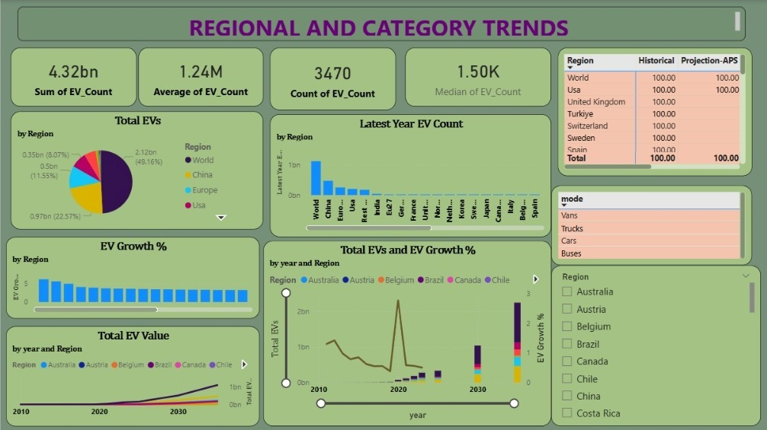

Slide 8
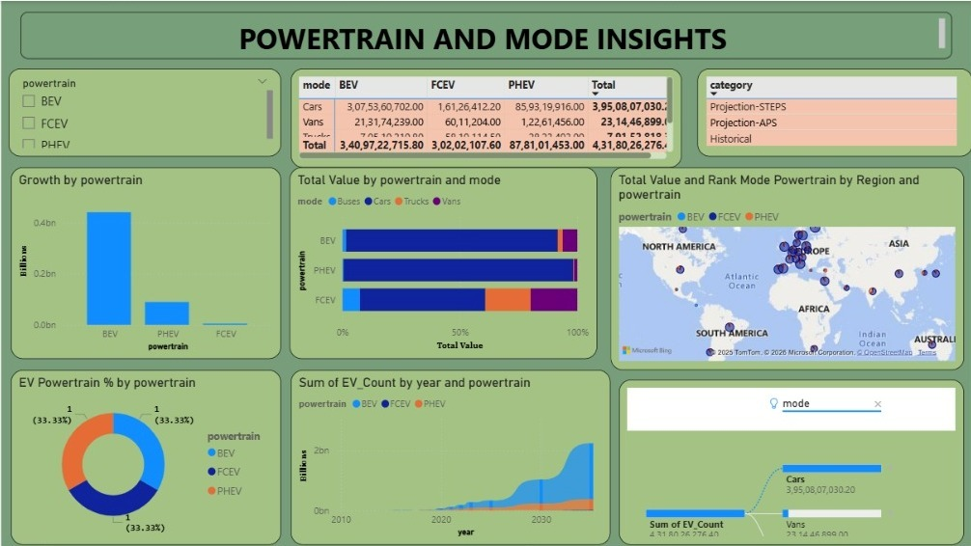

Slide 9
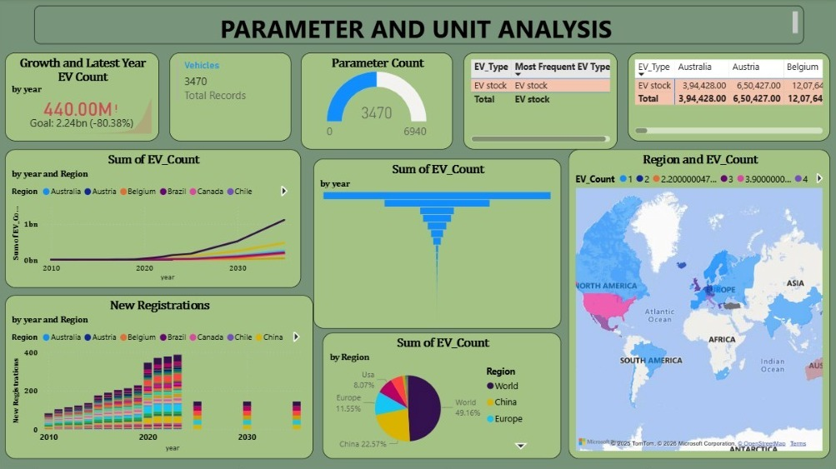

Slide 10
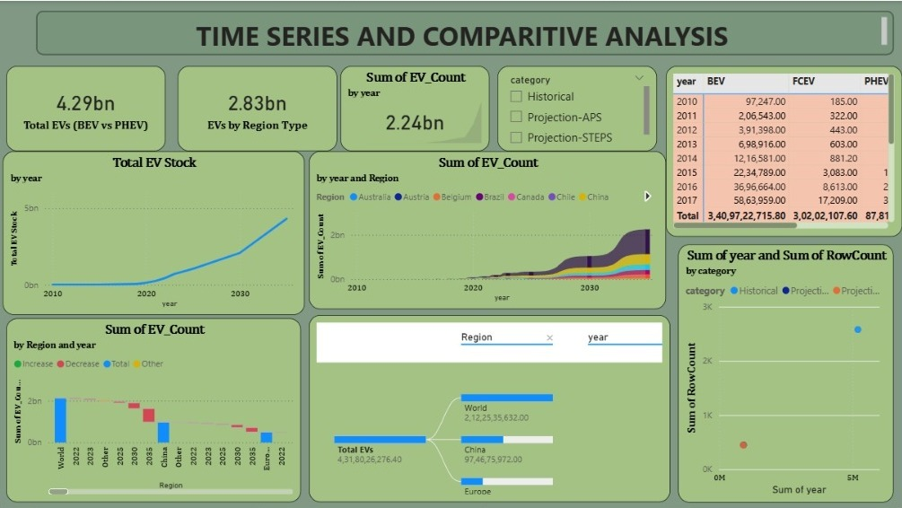

Slide 11
Insights
Strong exponential growth in EV adoption after 2018.
China, Europe, and the USA dominate global EV stock and sales.
Passenger cars account for the largest share of EV adoption.
BEVs are growing faster than PHEVs, indicating a shift toward full electrification.
Buses and 2-wheelers show high adoption in specific regions due to public transport policies.

Slide 12
Conclusion
The IEA Global EV dataset highlights the rapid global transition toward electric mobility, with strong regional dominance, increasing preference for BEVs, and significant growth driven by policy and technological advancements.

Slide 13
Recommendations
Expand charging infrastructure to support rapid EV adoption, especially in emerging regions.
Prioritize Battery Electric Vehicles (BEVs) through stronger incentives and policy support.
Electrify public and commercial transport such as buses and fleet vehicles.
Adopt region-specific EV policies based on infrastructure and adoption maturity.

Slide 14


Thank You!
e

